Slide 1
Challenge – Quality Education
How can we work together now for the world of tomorrow?
March 09, 2024

Slide 3
What is your Dream Project?

Slide 4
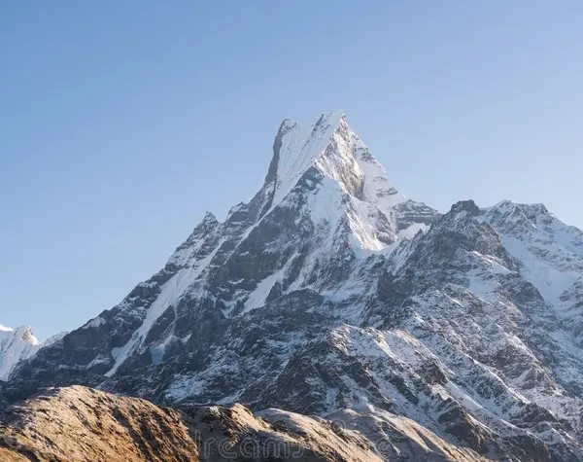
Climate Change – Before/After Pictures
Notes:
As a translator found out about climate change and wondered what can I/we do to have a positive impact on climate change. Talk about challenges and stuff but no examples to show what’s being done. Who are campaigning changing policies? Start a conversation about something that matters.

Slide 5
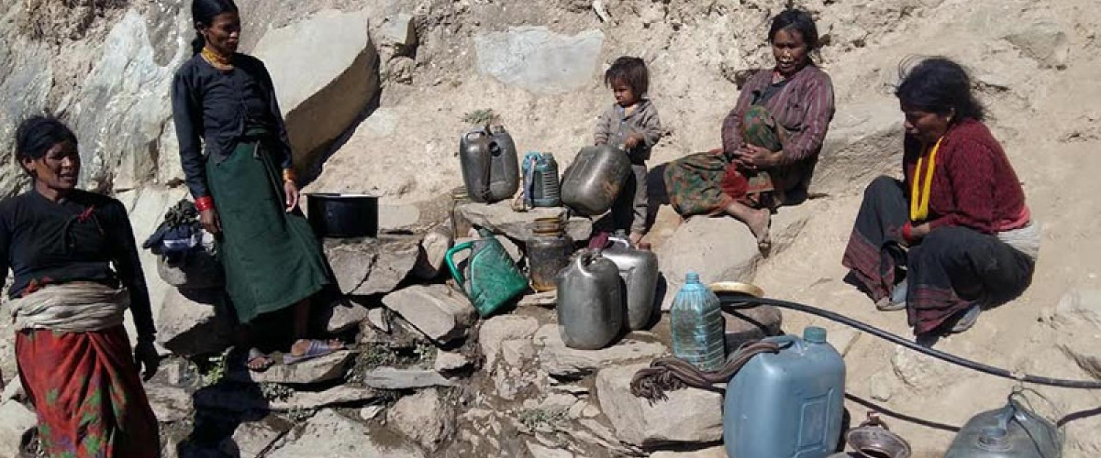
Climate Change – Water Shortage
Women and Children most affected

Slide 6
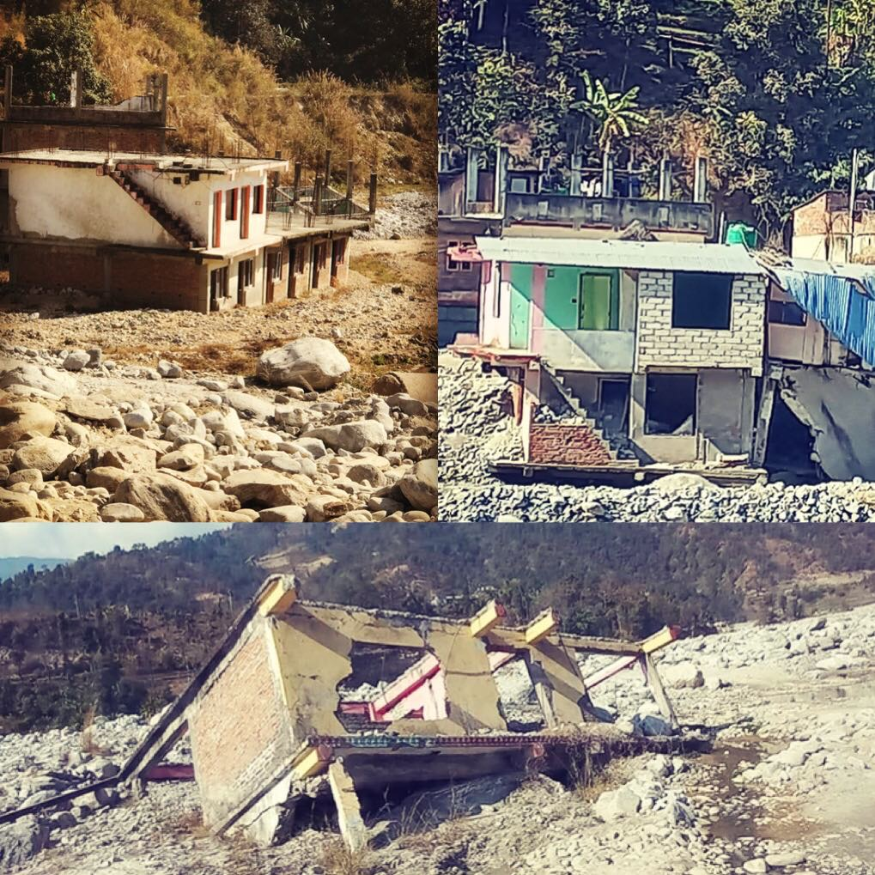
Climate Change - Flood

Slide 7
Climate Change – Mental Health

Slide 8
Hotter Temperature
More Severe Storms
Increased Drought
A Warming, Rising Ocean
Loss of Species
Not Enough Food
More Health Risk
Poverty & Displacement
Spread of Disease
Food Scarcity & Malnutrition
Poor Air Quality
Cost Lives
People at Risk
Affecting Mental Health
Low Production
The Biggest effect is
Challenge in Livelihood
Unwanted
MIGRATION
Climate Change
Generating Power
Manufacturing Goods
Deforestation
Using Transportation
Producing Food
Powering Buildings
Consuming Too Much
Climate Change: Problem Tree Analysis

Slide 9
We Can Make a Difference
Stop using electricity, stop driving car, stop flying, stop heating our home, stop using phones.
Possible?
Notes:
Yes!

Slide 10
Reduce Or Adapt
Climate change is outside our control (to some extent/at the moment)
What’s inside our control is the mindset
Notes:
Spoke to young people

Slide 11
A generation eager to learn and inspire.
Answer break downs to 3 simple answers:
1. Educate on the reality of situation
2. Organize/Engage – Encourage friends and family to and join
3. Lead – By example
Notes:
New found sense of optimism.

Slide 12
Youth Mobilization
Need youth led programs/projects
Gen z consists of 30% of world pop
Youth have time and energy, vision, passion and voice
Major source of untapped potential
Bear the burden of inaction and poor decisions

Slide 13
Challenge

Slide 14
Challenge
More than 2.1 million Nepalese out of Nepal - 18-35yrs
Over 100,000 left Nepal to study abroad in the FY 2023/24
Schools/colleges merging due to lack of students
150+ colleges Shut down
Not just going abroad they are leaving the country

Slide 15
Reimagining Education
Education is the passport to the future
The ability to read is a fundamental human right like access to clean drinking water or health care. It’s impact is everyday.
If children read they have a chance to make an impact to their life, community, country and eventually the world.
Envision education for social change.
Need to create opportunities
Need to create hope
Notes:
In this changed scenario, it is time to reimagine education. How can we do that?

Slide 16
Why ?
Primary education in Nepal is called Basic Education and consists of grades one through eight. Secondary levels are grades nine to twelve.
The free and compulsory education of children is a fundamental right under the Constitution of Nepal. The law ensures that all children get free and compulsory education up to class eight and free education from class nine to twelve in government schools.
However, only 27% of children in Nepal complete secondary school while 15% of secondary school age children are out-of-school.
Notes:
Awareness

Slide 17
Education Works but Literacy Matters
The basic inability to understand or produce written information
There are many forms of illiteracy. Financial, computer, health etc.
3 out of 4 children who get food from government perform lowest literacy levels.
82% students eligible for free lunch cannot read with proficiency
Notes:
What is literacy?
Awareness necessary

Slide 18
What affects the world the most? - 1 billion ppl are illiterate in the world
8.2 million with cancer, 17.3million with heart disease
If illiteracy was a health issue it would be an epidemic
Well the other diseases do not yet have a cure but the good news is that illiteracy does
Illiteracy is not social or cultural defect its just the lack of ability to read
Literacy is a solvable problem. It can help us stop hunger, poverty, and crime

Slide 19
How can we do that?
Notes:
Activity

Slide 20
Dream Project
Why is/was it your dream project? What is/was the reason?
Notes:
ACtivity

Slide 21
Superheroes

Slide 22
Congratulations! You might have a condition called western bias.
Social change needs engaged communities not super heroes
Socially culturally taught if we want change we have to work together
Connect and lead
You want to be superhero with mask where ppl are dependent on you or work in community where you want to give power to community and make them realize they are capable of fostering change
Superheroes do not transform societies they only fight evil on surface level.
Social change is intrinsicly related to social justice. Social justice is how society delivers wealth, opportunites and power among society members in equal and fair environment.

Slide 23
Ubuntu
Notes:
Ubuntu is an African philosophy that embodies the idea of interconnectedness, community, and humanity. It emphasizes the belief in a universal bond that connects all people, emphasizing the importance of compassion, empathy, and sharing. In the context of sharing food, ubuntu encourages individuals to share resources with others and to recognize the humanity in everyone by extending hospitality and kindness.

Slide 24
Sherbet
Notes:
Activity
Glass, Water, Sugar, Spoon

Slide 25
Livelihood
Tool to break harsh social cycles

Slide 26
What is Quality Education?

Slide 27
Notes:
Thank you. ☺

